Slide 1

Mapping with Tableau
Taught by: Liam MacLean and
SOCL 2358: Current Issues in Cities and Suburbs
Dr. Kayleigh Ward
Fall 2023

Slide 2
Workshop agenda
Learn about the Boston Area Research Initiative (BARI) Data Portal.
Learn about Tableau.
Understand how to import and modify data in Tableau.
Filter data in a variety of ways to produce custom visualizations.
Brainstorm sociological research questions BARI and Tableau could help answer.
All materials are available here: http://bit.ly/FA23-Kayleigh-Ward

Slide 3
Datasets and Maps

Slide 4
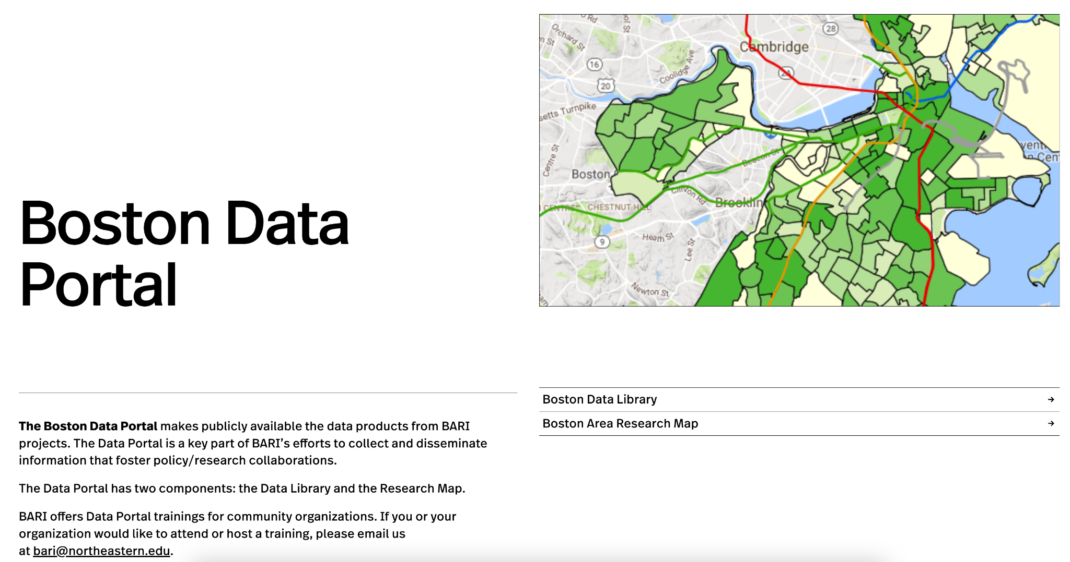
BARI Boston Data Portal
https://cssh.northeastern.edu/bari/boston-data-portal/

Slide 5
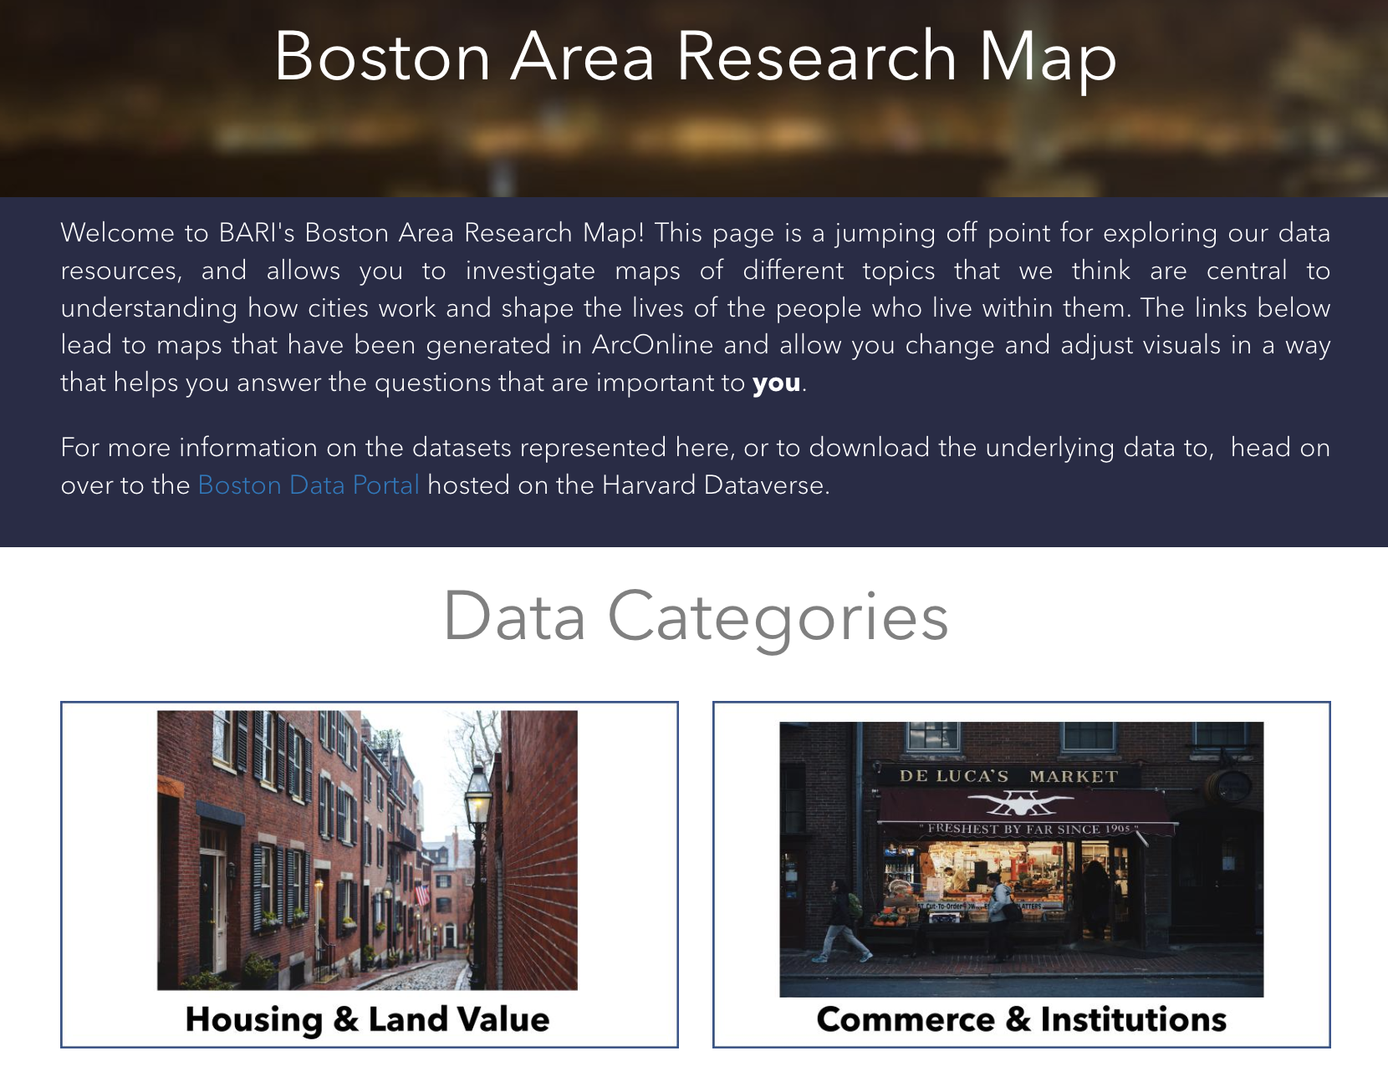
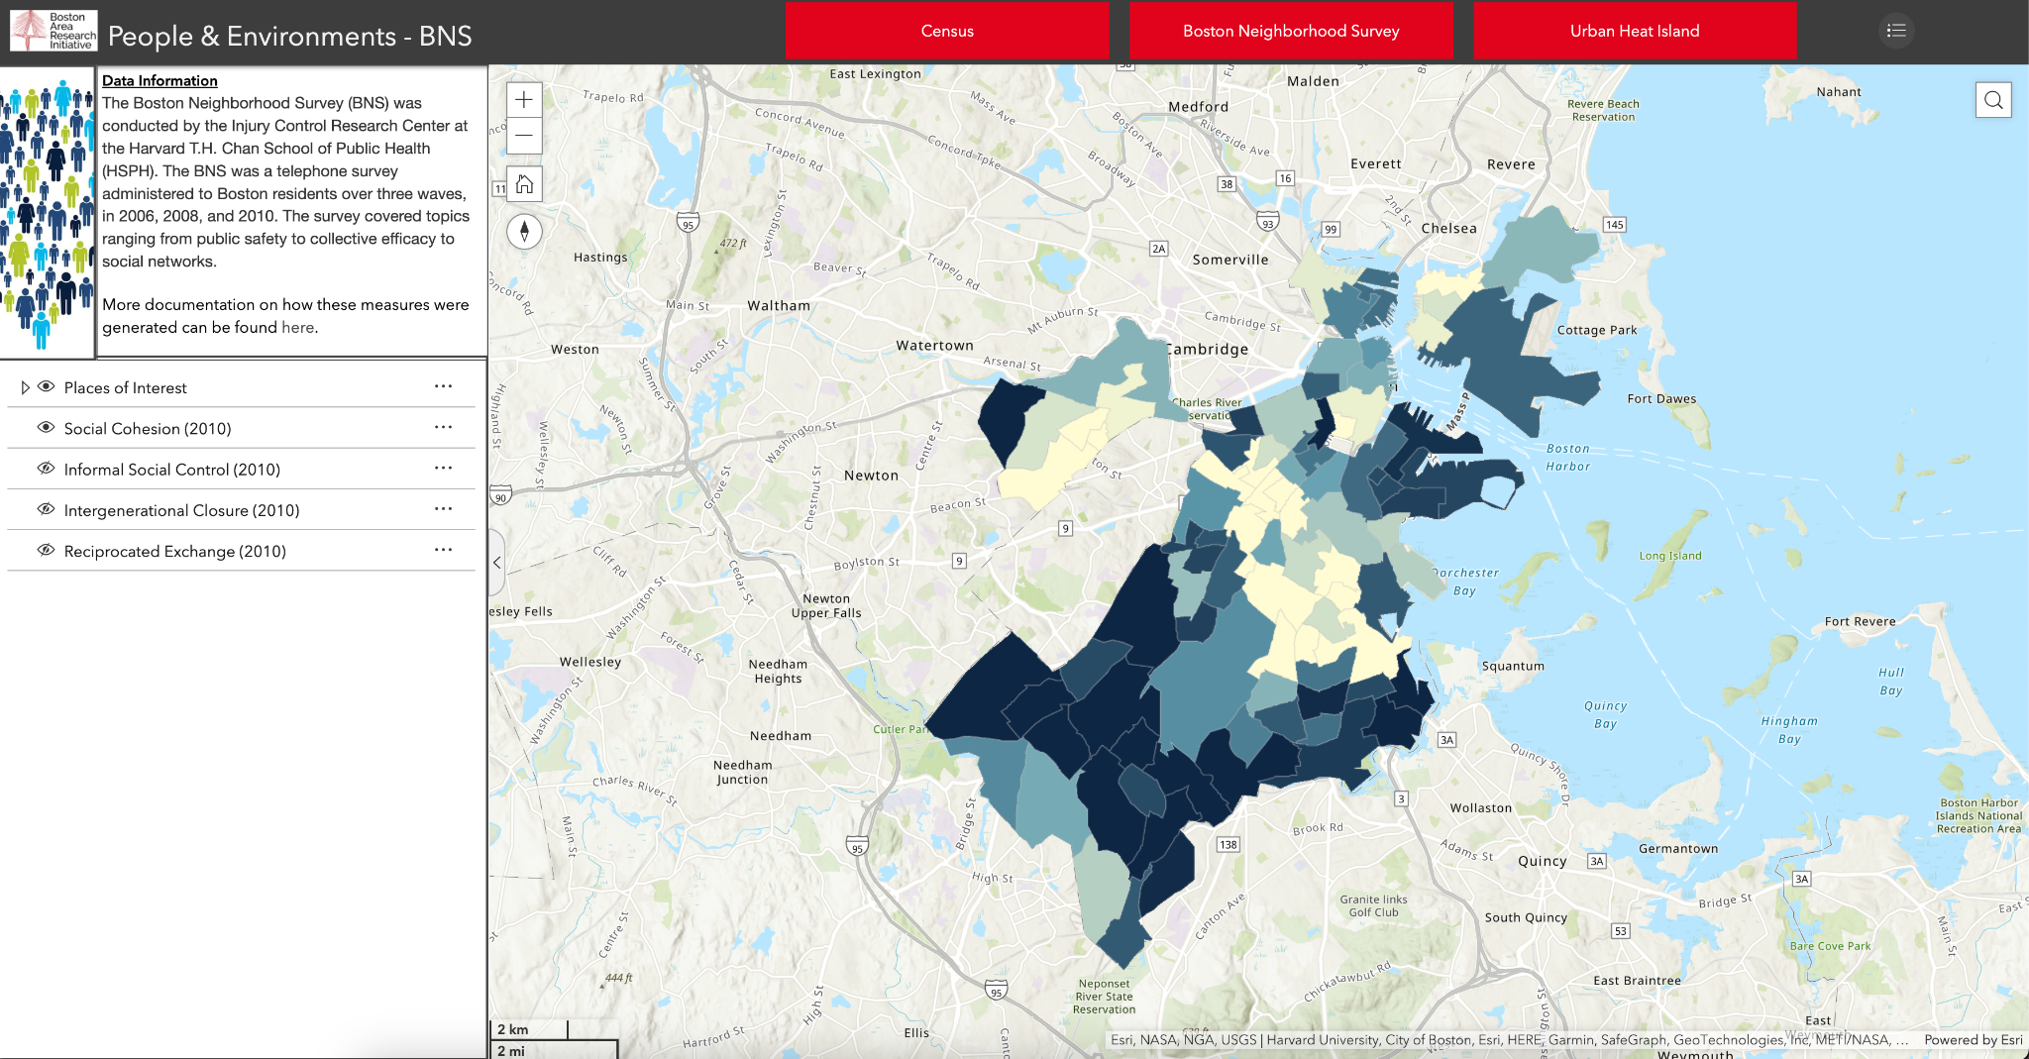
Boston Area Research Map
https://boston-area-research-map-nu.hub.arcgis.com/

Slide 6
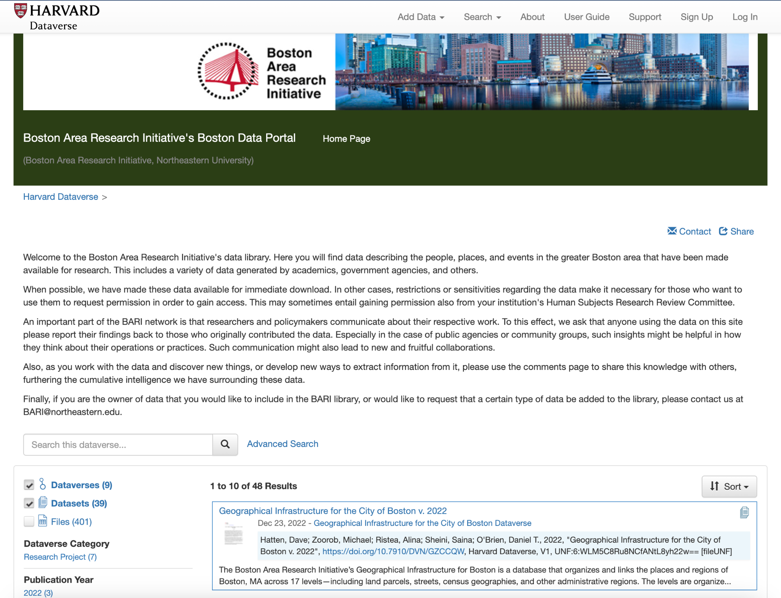
BARI’s Boston Data Portal
https://dataverse.harvard.edu/dataverse/BARI

Slide 7
Tableau

Slide 8
Tableau basics
Tableau is a powerful tool for different types of data visualizations. Tableau can also be used for mapping.
A Tableau license is available for free to students with a .edu email address. You can use the key on two different devices.
Link to Tableau for students: https://www.tableau.com/academic/students

Slide 9
Key terminology
X/Y Coordinates: Numerical values that allow every location on earth to be pinpointed.
Latitude: The north/south coordinate of a location based upon its distance from the equator.
Longitude: The west/east coordinate of a location based upon its distance from the standard meridian.

Slide 10
Key terminology continued
Dimension: Qualitative values (such as names, dates, or geographical data). You can use dimensions to categorize or segment your data.
Measure: Numeric, quantitative values that you can measure. Measures can be aggregated. When you drag a measure into the view, Tableau applies an aggregation to that measure (by default).
Basemap: The type of map that your coordinates are plotted on. Options include streets and satellite images, just like Google Maps.

Slide 11
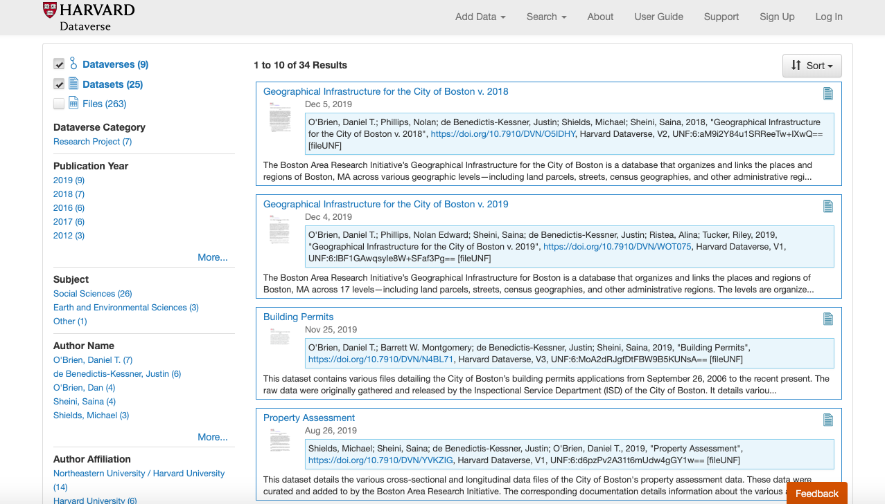
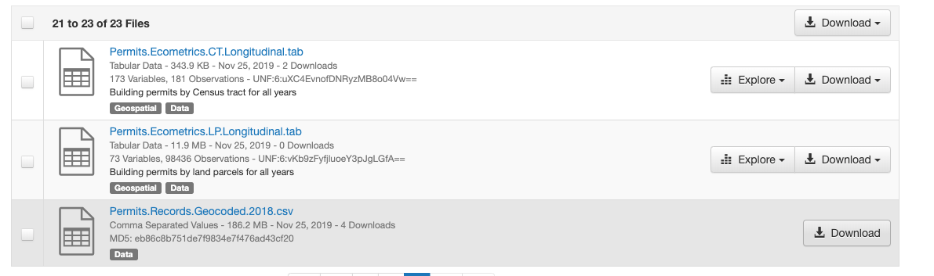
Our dataset

Slide 12
Our dataset
Boston’s 2018 Permit and Record Spreadsheet, which tracks construction permits.
Includes information such as
Type of permit (addition, renovation, etc.).
Address of permit (including geographic coordinates) and neighborhood name.
Permit holder and fee information.

Slide 13
Tableau Walkthrough

Slide 14
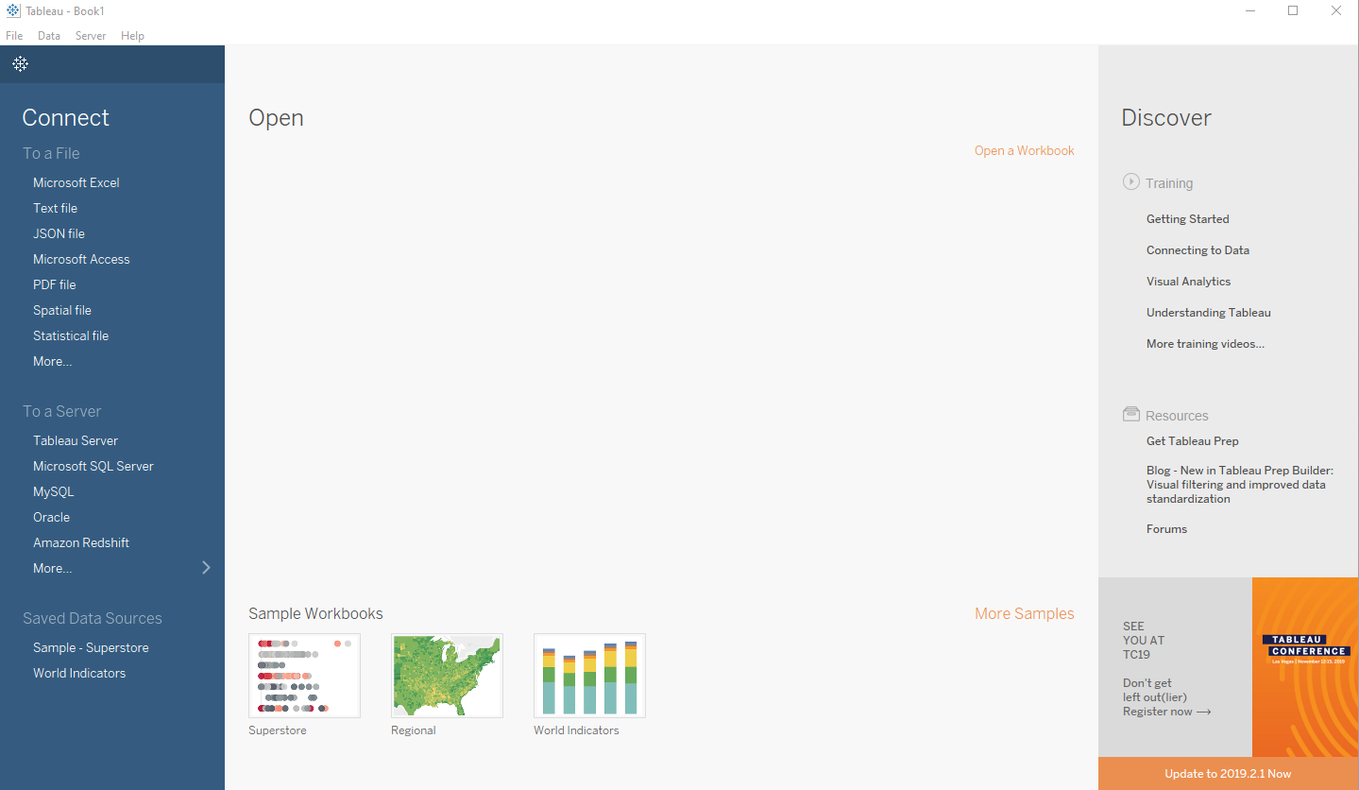
Step One: Connecting to data
First, we need to connect to our data.
We will be using building permit data for the City of Boston in .csv format.
Select More… and navigate to the data file that was sent via email.

Slide 15
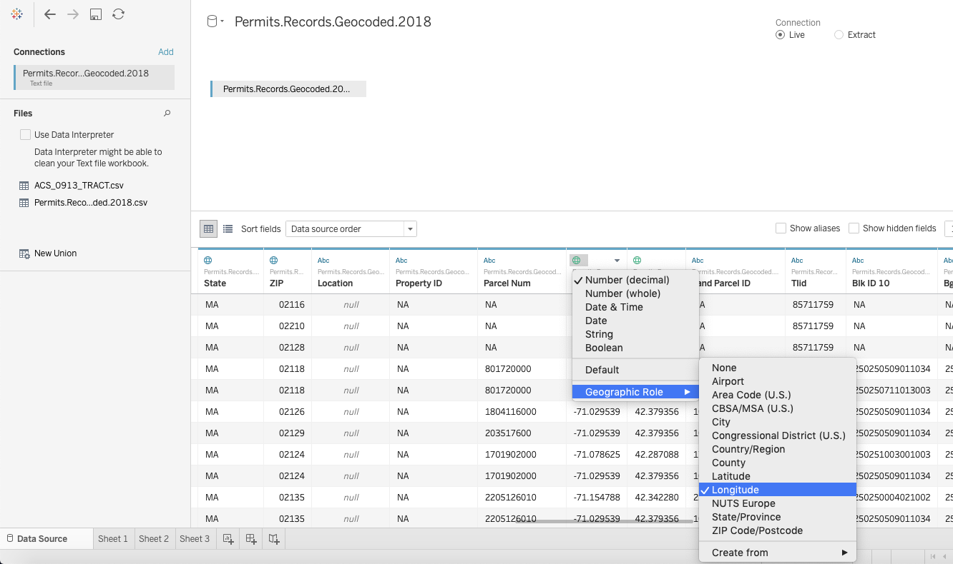
Step Two: Convert coordinate column to geo data
To map our data, we have to first convert the X/Y data into coordinates.
Click on the Abc, and change the data type from String to Number (decimal).
Click on the # and select over Geographic role, and then select Latitude or Longitude. Convert:
X -> Longitude
Y -> Latitude

Slide 16
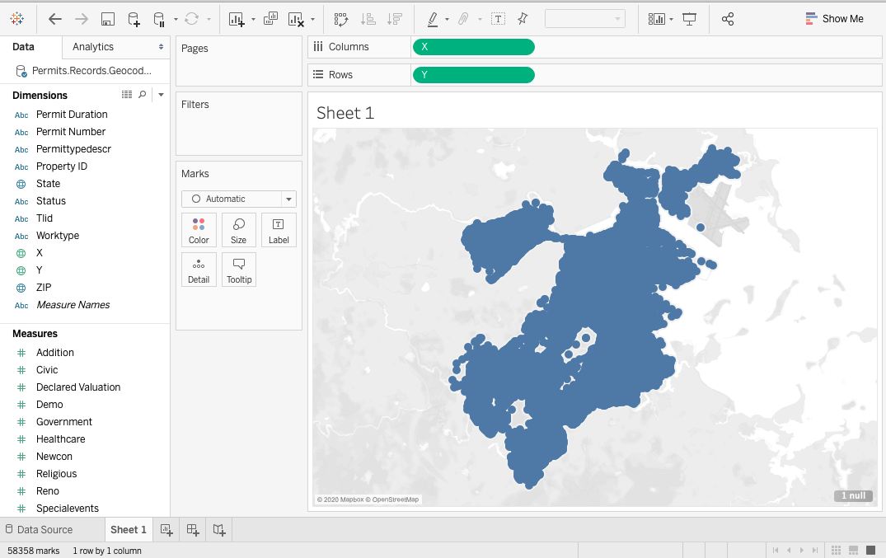
Step Three: Plotting points
To map the data points, drag the Y data into the Columns area, and the X data into the Rows area.
Tableau will automatically plot points based upon those X/Y coordinates.

Slide 17
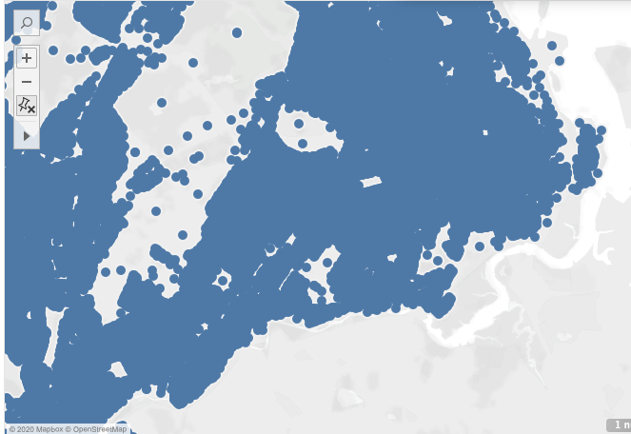
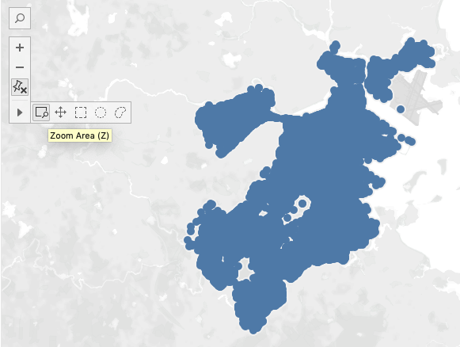
Step Four: Zoom controls
The navigation and zoom controls are in the top left of the plot area.
We have zoomed into the Downtown Boston, Fenway/Kenmore, Jamaica Plain, Roxbury areas.

Slide 18
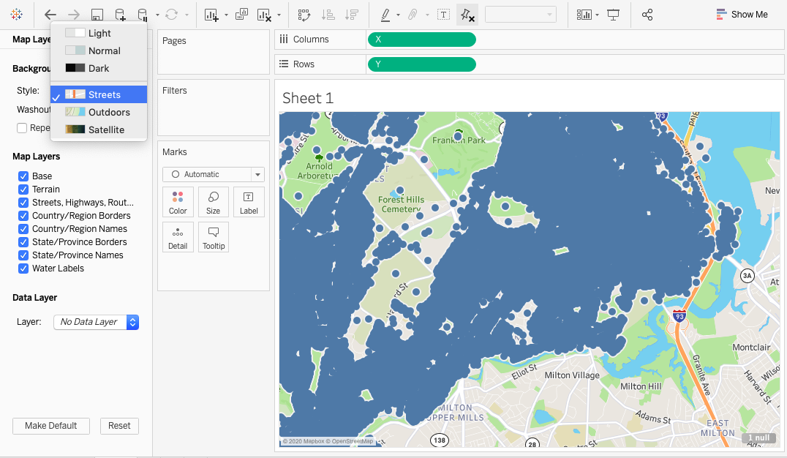
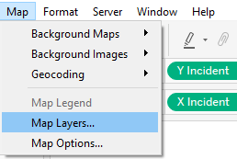
Step Five: Modifying the basemap
Select Map on the toolbar and go to Map Layers… to modify the basemap.
Select a new style, e.g. Streets.
When you are happy, click the X at the top of the map layers sidebar.

Slide 19
Hypothesis: Gentrification will look different in each neighborhood of study.
Operationalization: Gentrification can be tracked by filtering out Addition, Erection, New Construction, and Removal of Structure building permits.

Slide 20
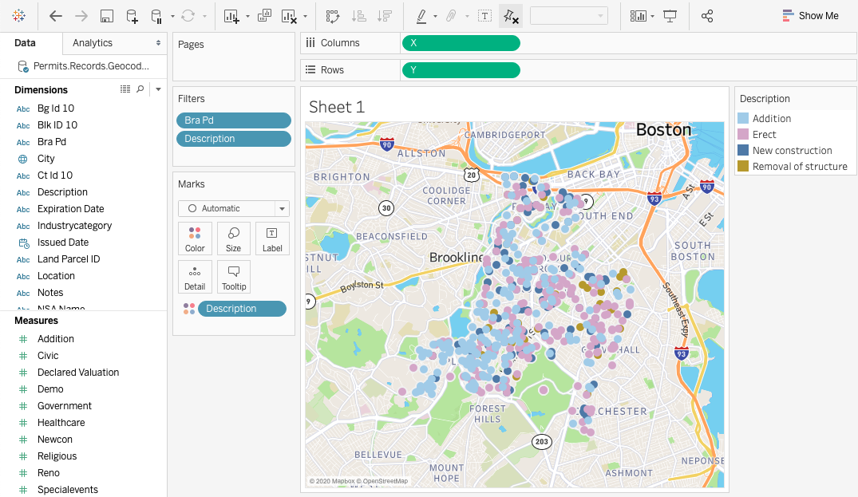
Step Six: Creating filters
To create different filters and visualization parameters, drag a dimension or measure into the Marks box. Change marks to Map.
To specify a type of visualization, drag the parameter of choice onto Color, Size, etc.
We have mapped Description of Permit Type as a color, and filtered by neighborhood and description of permit type (which will appear as a tooltip).

Slide 21
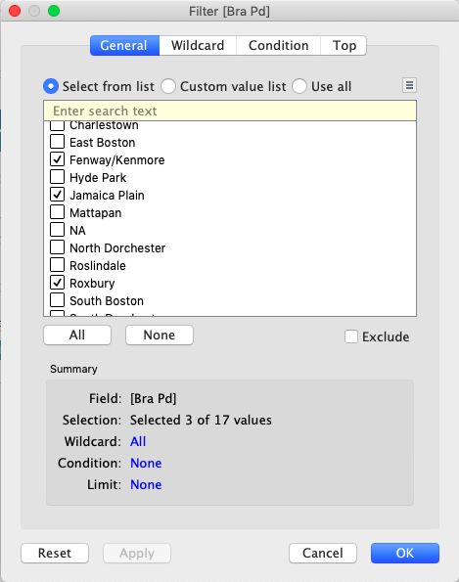
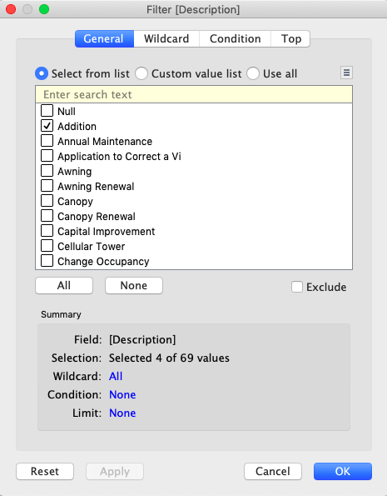
Step Seven: Creating filters continued
We want to filter our neighborhood data parameter to only display Fenway/Kenmore, Jamaica Plain and Roxbury.
Click on Filter… to bring up the filter box.
Deselect all and then check the boxes for Fenway/Kenmore, Jamaica Plain and Roxbury.
Do the same thing for permit description type, selecting the boxes for Addition, Erect, New Construction, and Removal of Structure.

Slide 22
Step Seven: Creating filters results
Notes:
Did the map support the hypothesis? (that gentrification will look different in each neighborhood of study)?

Slide 23
Tableau and Accessibility
Tableau lets you modify and customize how your maps and graphs look.
Keep accessibility concerns in mind when choosing fonts and colors.
Colors with higher contrast from the background are easier to distinguish.
Larger, bolder fonts stand out and designate importance.
Overcrowding text makes the information harder to read.

Slide 24
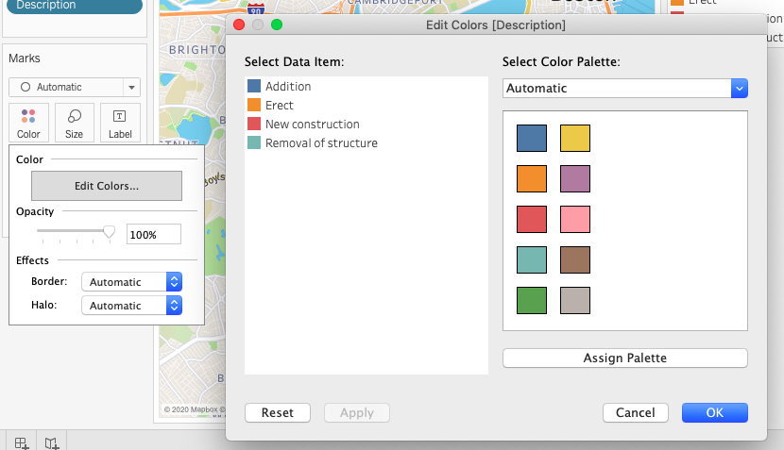
Step Eight: Modifying colors
The standard map colors don’t contrast very well.
On the Bra Pd (neighborhoods) sidebar, click the dropdown arrow, then click on Edit Colors….
We can now change our colors and improve the contrast.

Slide 25
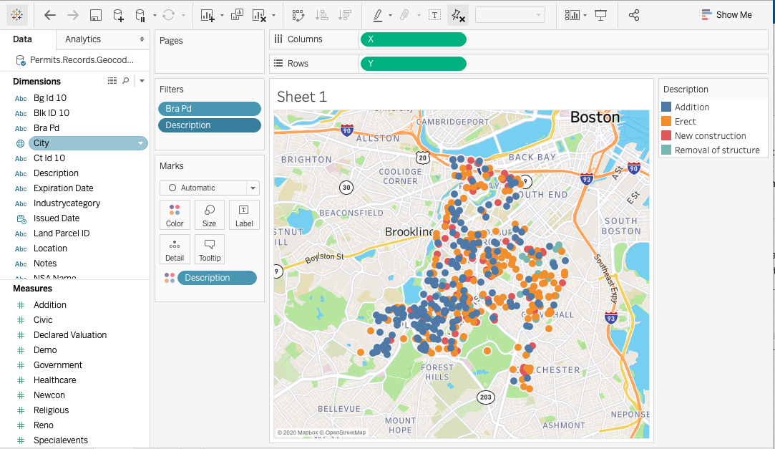
Step Eight: Modifying colors results

Slide 26
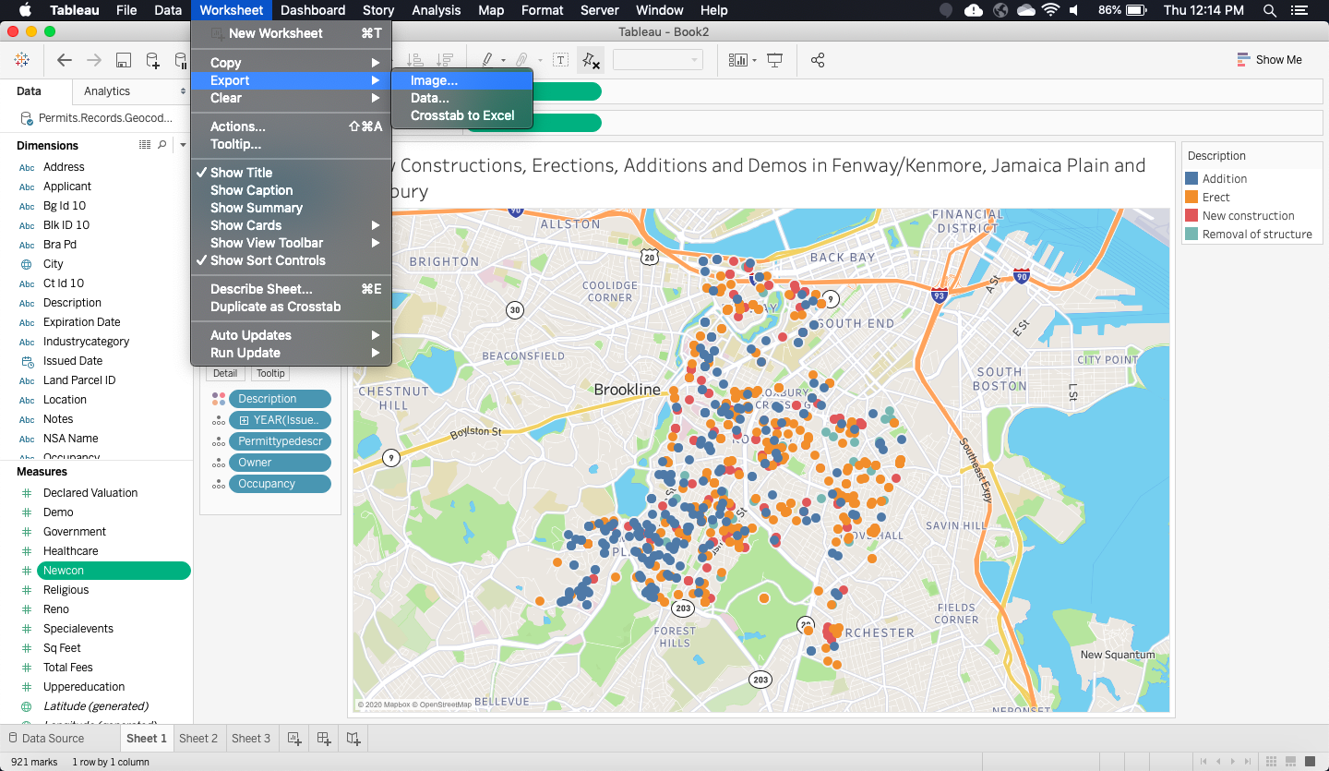
Step Nine: Exporting images
From the Worksheet drop-drop down menu, select Export, then click on Image….
You can select the type of export then click Save.

Slide 27
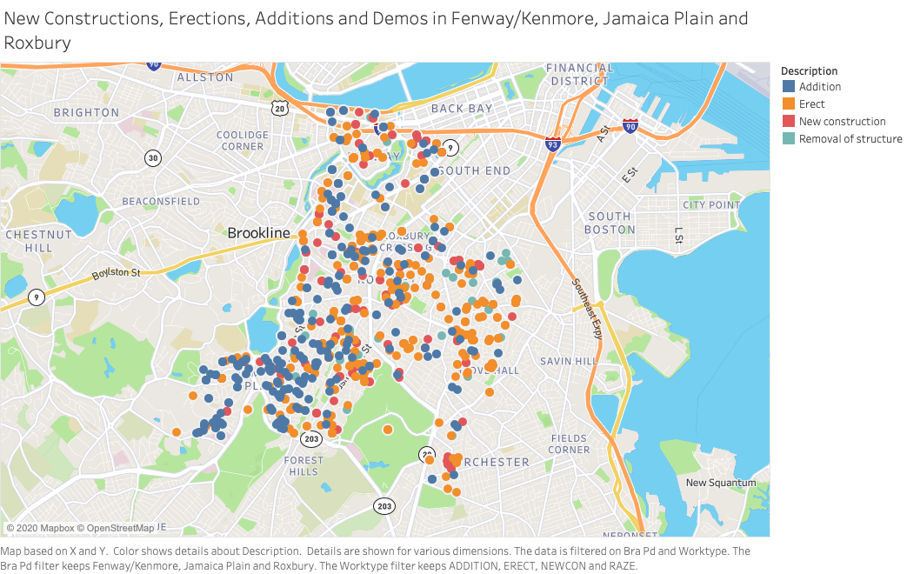
Step Nine: Exported image

Slide 28
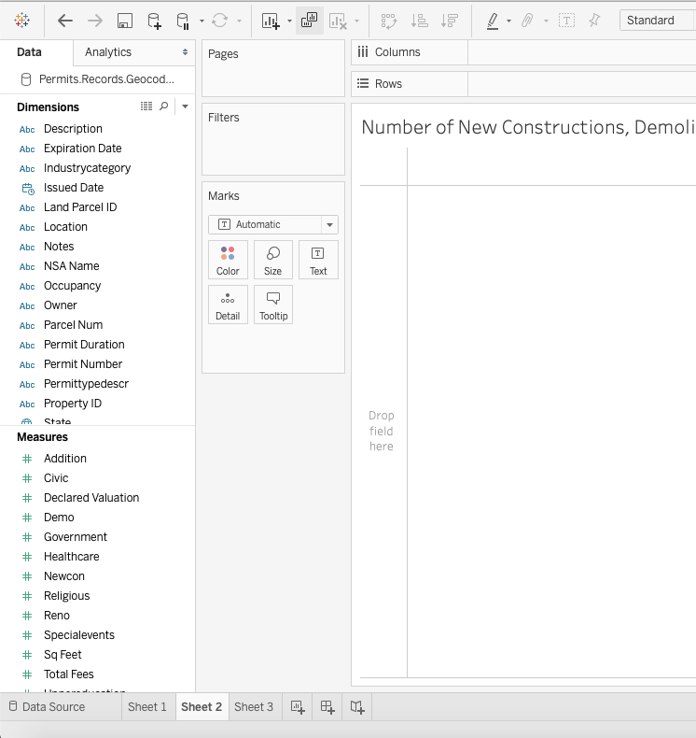
Graphs with Tableau: Drag & drop
As with mapping, creating a graph can be accomplished by dragging and dropping our dimensions and measures.
To map the number of records over time according to permit type, first create a new sheet (click the + sign next to Sheet 1 at the bottom).
Next, drag and drop the Issued Date dimension to the columns, and the Addition, Demo, Newcon and Reno measures to the rows.

Slide 29
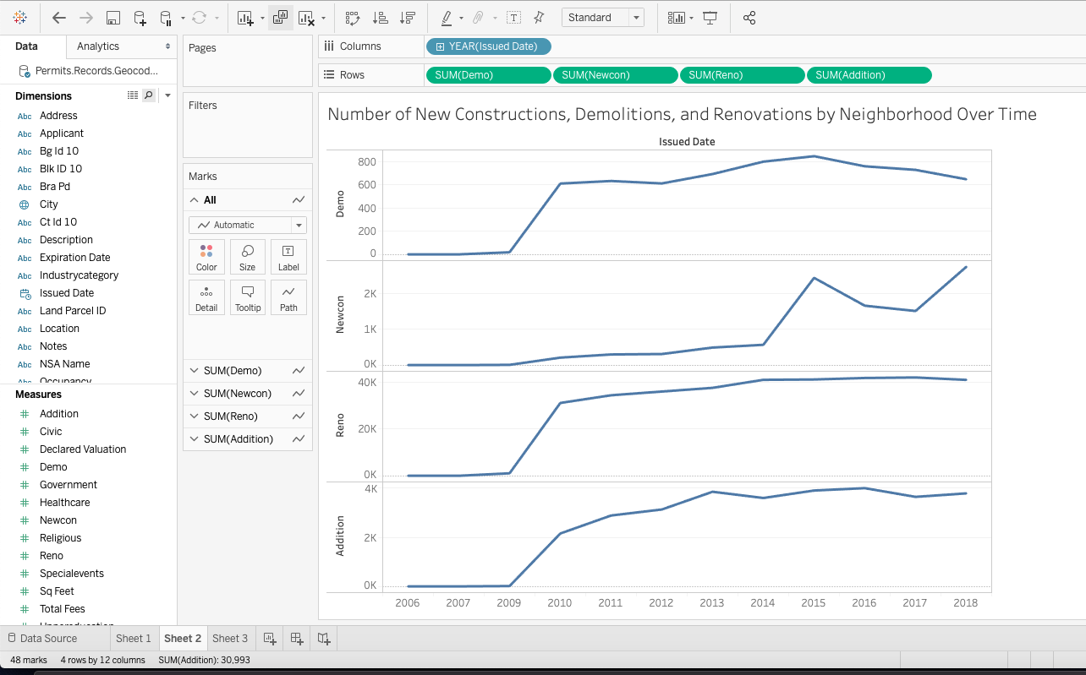
Graphs with Tableau: Drag & drop
We now have a graph of different building permit records over time. To see specific neighborhoods:
Drag and drop the Bra Pd measure onto both the filter box and the colors in the marks box to the left of our new graph. Filter your neighborhoods to include only Fenway/Kenmore, Jamaica Plain and Roxbury.
Tableau will automatically set each neighborhood to a different color and redraw our graph.

Slide 30
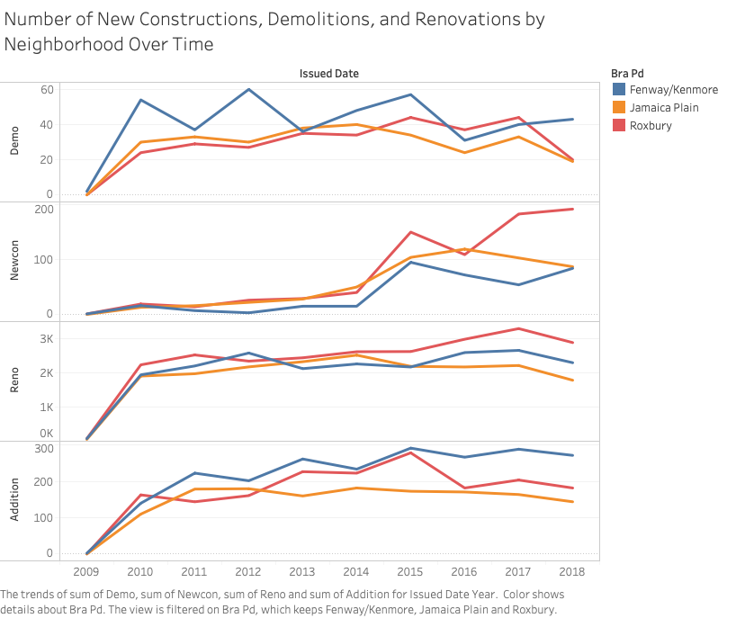

Slide 31
How can Tableau help us to answer sociological questions?

Slide 32
Example research questions
How much value are new constructions and renovations adding to their neighborhood over time?
How much value does each type of construction add to each neighborhood’s overall valuation?
What different types of industry are building in these neighborhoods?

Slide 33
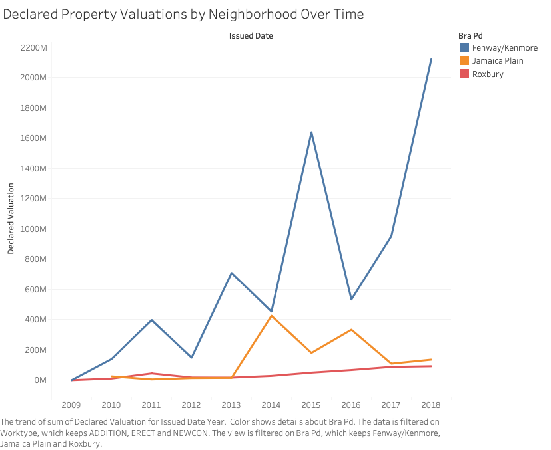
How much value are new constructions and renovations adding to their neighborhoods over time?

Slide 34
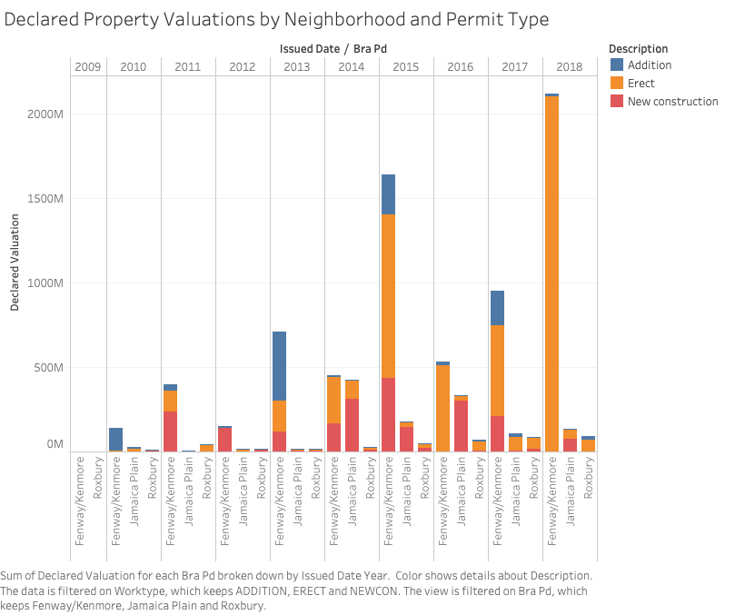
How much value does each type of construction add to each neighborhood’s overall valuation?

Slide 35
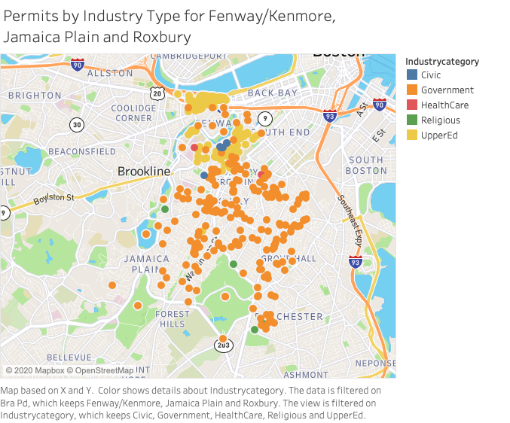
What different types of industry are building in these neighborhoods?

Slide 36
Conclusion
Tableau is a powerful tool for mapping coordinate points onto maps.
Tableau is also very powerful at creating a variety of charts and graphs by dragging non-coordinates to the ‘column’ and ‘row’ areas.
Research questions can include a number of different dimensions and measures—do not be afraid of experimenting with different visualizations!

Slide 37
Thank you!
Liam Maclean
Digital Integration Teaching Initiative
Fellow
_______
Digital Integration Teaching Initiative
Fellow
_ _ _ _ _
If you have any questions, contact us at nulab.info@gmail.com
Have questions? Schedule an appointment with us! https://bit.ly/diti-meeting
Link to Online Materials: http://bit.ly/FA23-Kayleigh-Ward
We'd love your feedback! Please fill out a short survey here: https://bit.ly/diti-feedback

